Slide 1
Czech strategy for cooperation with the Indo-Pacific
Martin Tlapa
Deputy Minister
Prague, November 2022

Slide 2
Closer Than We Think

Slide 3
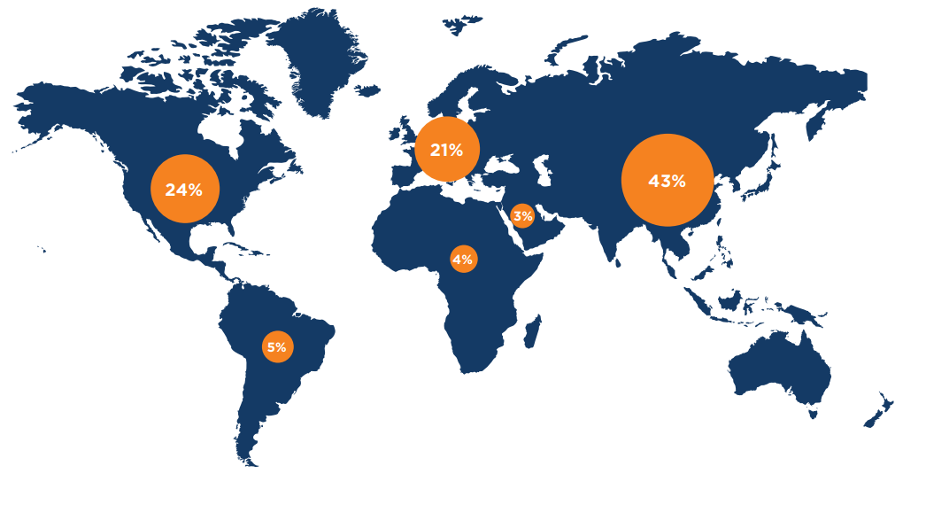
World economy by regions in 2035
Global GDP distribution forecast by 2035
Notes:
Původní predikce
Asie 35>43
Evropa 26>21
US 28>24
Evropa + US 21+24 = 45 % X Asie 43 %
Afrika, LA pravděpodobně takto neporostou
Co tento slide říká?
Motorem světové ekonomiky bude v následujících letech Asie

Slide 4
Czech Republic and Indo-Pacific – trade in goods
2012 – 2021 (mil. USD)
Notes:
Původní predikce
Asie 35>43
Evropa 26>21
US 28>24
Evropa + US 21+24 = 45 % X Asie 43 %
Afrika, LA pravděpodobně takto neporostou
Co tento slide říká?
Motorem světové ekonomiky bude v následujících letech Asie

Slide 5
Why is the Indo-Pacific important?
The fastest growing region in the world, 60 % of total world population, 42 % of world GDP, vital trading, transport and shipping routes
Among prime movers of global technological and social growth
Opportunities for greater activity and mutual trade and investment
Like-minded partners and regional economic and security target-oriented groupings (CPTPP, IPEF, RCEP, AUKUS, Quad)
Region where values compete and superpowers’ interests clash

Slide 6
Why is the Indo-Pacific important for Czechia?
Czech solutions and expertise, based on our long history and presence in the region, awareness and good reputation of our products and services
Active engagement beyond the EU Presidency, bilaterally + partnerships in line with fundamental principles of Czech foreign policy
Support to FTAs with the EU, participation in Team Europe Initiatives and Global Gateway
Opportunities for Czech companies in trade, investment; synergies with development cooperation
Partner in promoting effective multilateralism, joint projects in defence and security, cyber security, science and research, human rights
Rule of law for a free and open Indo-Pacific

Slide 7
Vision and priorities
Cooperation with the Indo-Pacific countries to promote global security and prosperity as well as respect for human rights and dignity
Priorities to follow: partnerships, security, prosperity and sustainability
Strict adherence to the fundamental principles, open and rules-based partnerships to promote the UN value framework
Security challenges to be coordinated with allies, like-minded partners and multilateral mechanisms
Good and transparent economic relations for prosperity, encouraging diversification of trade and supply chains
Focus on innovation and new technologies, digital partnerships, sustainability in line with Agenda 2030

Slide 8
1/Partnerships
1) Development of partnerships with individual countries in the region – deepening cooperation with like-minded partners, promoting the transatlantic link
2) Cooperation with Asian regional structures, especially with ASEAN
3) Promotion of good governance and human rights – promoting international human rights standards and open dialogues with national governments
4) Promotion of rules, international law and free trade via effective multilateralism

Slide 9
2/Security
5) Cooperation in the area of cyber security and in combating cyber-crime, building resilience, counteracting hybrid threats, and preventing and combating terrorism and violent extremism
6) Security dialogue – enhanced cooperation on the level of defence ministries, focus on defence industry
7) Assistance with disaster prevention and disaster risk reduction (including humanitarian disasters), and strengthening the resilience
8) Support for the activities of security organizations and conflict prevention mechanisms

Slide 10
3/Prosperity
9) Increasing the visibility of the Czech Republic
10) Increasing the presence of the Czech Republic and Czech companies in the region (economic diplomacy projects, regional events, export and investment promotion tools)
11) Academic, scientific and technical and inter-university cooperation, people-to-people cooperation
12) Diversification of and better integration in trade and supply chains – helping to reduce protectionist policies, addressing tariff and non-tariff barriers via fully functioning multilateral trade system, EU trade policy

Slide 11
4/Sustainability
13) Sustainable agriculture, circular and green economy, workforce mobility
14) Climate protection, biodiversity protection, energy and carbon sustainability – support for trade and sustainability development (TSD) in trade agreements
15) Active raw materials diplomacy – tailored expertise for Indo-Pacific partners to cover their whole raw materials cycle
16) Support of regional cooperation, active role in the implementation of the EU-Asia Connectivity Strategy
17) Building of healthcare capacities as a part of comprehensive post-COVID-19 recovery and renewal

Slide 12
Balancing pragmatism…
Shared responsibility and cooperation with partners – balanced approach to individual countries and the whole region while promoting an international rules-based order
Reciprocity, transparency, level playing field – coordinated and balanced relations, closer inter-ministerial coordination
Support for the strategies and activities of the EU, NATO, UN and like-minded Indo-Pacific partners, including through the Czech Republic's activities in the UN

Slide 13
… and synergies
Synergy between the national strategy and the EU strategy for the Indo-Pacific – close link with like-minded initiatives and programmes (EU, UN, NATO, other allies and partners in/out the region)
Participation in projects of the EU and like-minded partners, including projects of the UN, OECD, regional banks and other partners
More efficient use of all EU relevant instruments related to the region, including the NDICI/Global Europe – locating synergies within the EU using the Team Europe approach

Slide 14
Conclusion
Indo-Pacific will have a decisive influence on the dynamism of the 21st century world
Equal partners and mutually advantageous cooperation
Be ready to tackle challenges, region's risk factors, security risks and hybrid threats
Specific project-based cooperation and long-term cooperation in selected areas
Shared values and interests, framework of the EU, cooperation with allies and like-minded partners

Slide 15
Thank you for your attention
Martin_Tlapa@mzv.cz
@TlapaMar

