Slide 1
PPP projects in Energy Sector and related issues
State Property Committee
May 15, 2012

Slide 2
Infrastructure Investment Needs and
Energy Sector

Slide 3
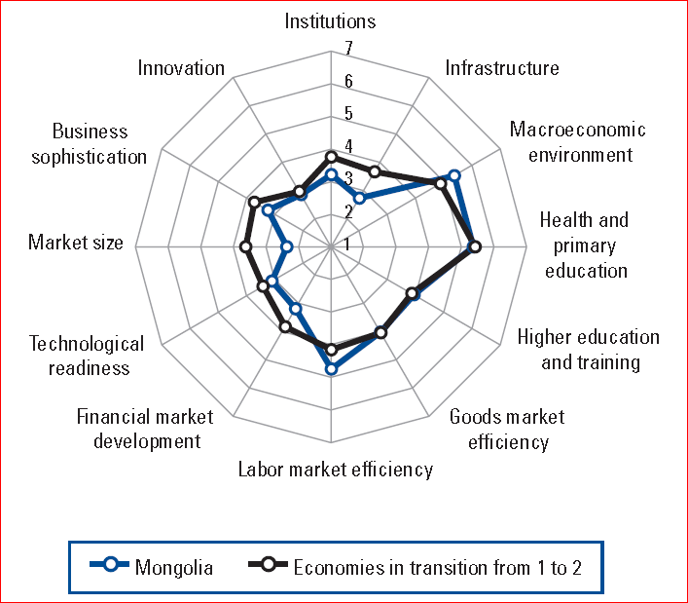
Current situation of Mongolian development
Mongolia ranked at 96 out of 12 countries
according to the
Global Competitiveness Index
Infrastructure is the lowest scored
indicator except Market Size
Mongolia is facing enormous
infrastructure gap in UB, in rural
areas:
in power generation and transmission
transport and general municipal sectors
Notes:
Stage of development
Factor driven economy
Effectiveness driven economy
Innovation driven economy

Slide 4
Strong economic growth is projected, thus requires more development of basic infrastructure specially Energy Sector Infrastructure
In the next 15 years, Mongolian economy is estimated to be more than 10 times of 2011
In 2025
GDP: ~USD 60.0 billion
GDP per capita USD 20,000
In 2016
GDP: ~USD 25.5 billion
GDP per capita USD 11,290
2011
GDP: ~USD 6.1 billion
GDP per capita USD 2,227
Source: National Statistics Office of Mongolia

Slide 5
Infrastructure investment estimate shows huge needs of contribution from the private sector
Estimated infrastructure investment needs total USD 8.0 - 10.0 billion over next decade (USD 5.2 billion in southern Mongolia alone)
Funding Gap is beyond the Government’s means and expected to come from Private Sector
Current budget constraints and budgetary policies restrictions as a result of the adoption by the Parliament of the "Fiscal Stability Law" will limit the Governments' financial capacity to solve this "infrastructure gap“ for the time being.
USD 110.0 million allocated for the Energy Sector Investment in 2012 State Budget
Investment Needs
State Budget / ODA etc.
Funding Gap
Private sector
Эх сурвалж: Худалдаа хөгжлийн банк, Дэлхийн банк

Slide 6
PPP in Energy Sector
Proposed projects in
PPP project pipeline
16 Energy Sector projects are included in the list, totaling USD 5.0 billion
Appropriate for
PPP Modality
7-8 Energy Sector projects totaling USD 1.2 billion are considered to be suitable for PPP Modality
Energy Sector PPP Projects that are being developed/ implemented
Mogoi River Power Plant
CHP-5
Dornod Power Plant
Transmission Grids
Waste processing/ energy generation project
Dornod Oil Refinery

Slide 7
PPP in Energy Sector: Advantages
Help increase investment in Energy Sector infrastructure utilizing Private Sector funding if the government budget is constrained.
Risk transfer and efficient allocation—PPPs relieve the government budget of some project risks, while efficient risk allocation between parties improves incentives and should reduce overall project cost.
Whole-of-life costing—a single contract spanning the design, construction and operation of an asset gives the operator an incentive to strike the efficient design balance between capital costs on sound construction and the expected level of operation and maintenance costs over time.
Notes:
Stage of development
Factor driven economy
Effectiveness driven economy
Innovation driven economy

Slide 8
PPP in Energy Sector: Advantages
PPPs also improve accountability in public expenditure through transferring service delivery risk to the private party. This means the government only pays for services delivered at the specified quality over the contract period. This is in contrast with traditional public procurement, where the government often has no recourse when, for example, construction quality is revealed after the event to be lower than expected.
Allows introduction of eco-friendly, modern, innovative technology or financial structures, access to international best experiences, private sector management skill to the Energy Sector.
Notes:
Stage of development
Factor driven economy
Effectiveness driven economy
Innovation driven economy

Slide 9
PPP in Energy Sector: Issues
Public Sector Capacity & Commitment
Comprehension of PPP concept & process is unequal/insufficient not only in Energy but all Public Sector.
Lack of cooperation/support with regard to project preparation, due diligences and tender process, delay of urgent actions that relevant entities should take
Government Support
Various types of government supports that enabled according to the State Policy on PPP and Concession Law are not yet put in place or unclear how to implement
Critical stance or opposition to Budget support/subsidies for PPP projects that are high-priority, economically viable, with high Value-for-Money but not financially viable
Legal Framework for indirect government support or contingent liability needs to be developed.
Notes:
Stage of development
Factor driven economy
Effectiveness driven economy
Innovation driven economy

Slide 10
Thank you!

