Slide 1
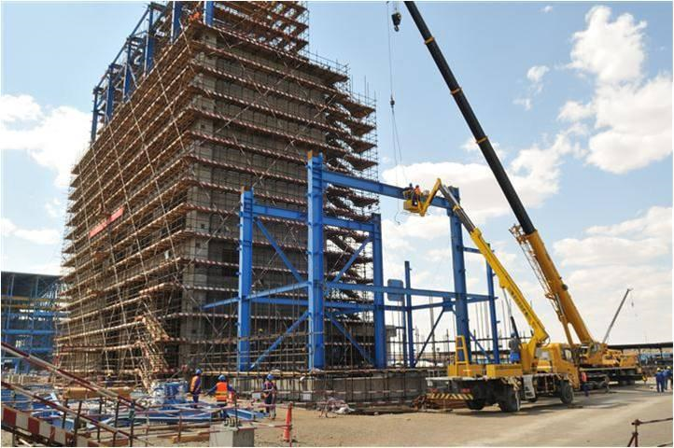
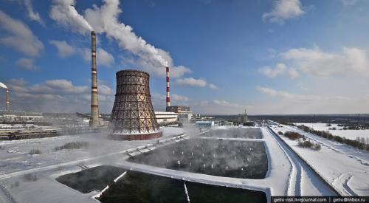
THE DEVELOPMENT
BANK OF MONGOLIA
May , 2012

Slide 2
OVERVIEW ON DBM
May , 2012

Slide 3
Development Bank of Mongolia Highlights
Inaugurated on May 12, 2011 as the development policy bank to provide long-term financing for projects consistent with the Government Development Strategy.
100% state-owned bank under the Development Bank of Mongolia Law.
Key instrument for implementation of the State Policy for industrial and infrastructure development projects.
Promote regional development and assist reduction of urban-rural disparities.
Facilitate co-financing strategic projects with foreign and domestic investors.
Total Equity 43 bln MNT as of 1st quarter of 2012.
Successfully established USD 600 million EMTN Programme.

Slide 4
Scope of DBM Financing by Law
DBM shall provide loan to the projects and programs that are approved by the Parliament and Parliament shall approve the projects and programs each year during its spring session (Article 8.1 of DBM Law)
DBM can provide financing for the Parliament approved projects stated in the
Article 8.1 in case there is Government guarantee for those projects and
programs.
The Board of DBM shall approve the list of projects and programs to be financed by the source that DBM raised without Government guarantee. (Article 9.3 of DBM Law)

Slide 5
Scope of DBM Operation
Currently approved projects and programs by
Parliament Resolution # 15 of 2011:
1. “New Development Program” – Parliament Resolution # 36 of 2010
2. “State Policy on Railway Transportation” – Parliament Resolution # 32 of 2010
3. “Sainshand Industrial Park” – Parliament Resolution # 47 of 2010
4. “The list of road and power infrastructure projects which are to be self-financed and reimbursed afterwards” – Parliament Resolution # 47 of 2008

Slide 6
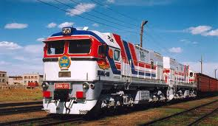
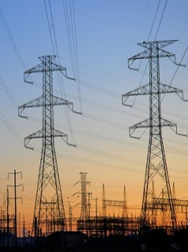
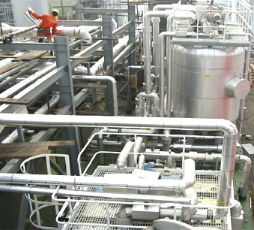
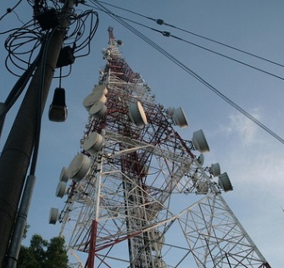
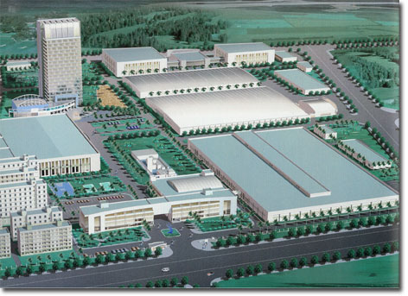
Projects and Programs
Primary focus on infrastructure and industrial development
Integrated Mining & Railway Strategy
Infrastructure & Urban Development
Sainshand Industrial Park
Quadrupling its rail network will allow Mongolia to fully capitalize in its commodity endowment
Strengthen Mongolia’s bargaining power for its resources
Access to currently untapped metal deposits in Mongolia
Current infrastructure capacities no longer meet increasing demand of quality basic public services
Improvements to current infrastructure would include:
Energy
Transportation
Telecommunications
Infrastructure for housing projects
Creation of downstream industries would enable Mongolia to achieve a more diversified and balanced economic growth
Located in southern Mongolia with intersecting rail access on Tavan Tolgoi-Choibalsan railway
The industrial complex could include an oil refinery, copper smelter, coking coal plant and water supply network

Slide 7
Available funding sources at DBM
Bond Issuing: Euro Mid-Term Notes (EMTN) Programme
- We already successfully issued USD 600million in international market in
March 2012.
Feasibility Study Fund:
Foreign Government Fund such as EDCF, JAICA, ADB, Kuwait Fund
On lending: MOU with international banks
- DBM is working to raise fund without Government Guarantee in order to provide financing for economically important projects.
MOU with Kuwait Fund for Arab Economic Development
MOU with Kuwait Investment Authority
MOU with China Development Bank
MOU with SMBC
MOU with US EXIM

Slide 8
Requirements of DBM Financing (by Law)
Main conditions on DBM loans:
Having interest rate below the average interest rate of other banks; providing preferential terms of loan.
Loans must be backed up by loan collateral, guarantees and other methods of ensuring the obligation fulfillment
Main requirements for the project and programs to be financed by the DBM:
Belonging to strategically important and priority sectors which are determined and approved by the Government;
Having its design, budget and economical and technical feasibility study developed;
Supporting economic growth, or aiming to produce value added goods that meet international and EU standards, and are exported, or substitute import products

Slide 9
What DBM can do for the development projects
Role of DBM
Debt financing
Bilateral lending: If the project meets our legal requirement, we can provide direct loan to the project which are small or medium size
Equity financing
We can also provide equity financing with our own funding sources for the projects which need strategic investments.
Financial Advisor
We can provide financial advisory services to structure the financing scheme, find relevant source of funding, structure the project and negotiate with international financing sources for Mongolian companies.
Co-financing : For larger scale projects we can provide or arrange co-financing with Multilateral Agencies such as World Bank, ADB, IFC, EBRD, and also international syndicated loan

Slide 10
POSSIBILITIES of DBM to SUPPORT ENERGY SECTOR
May , 2012

Slide 11
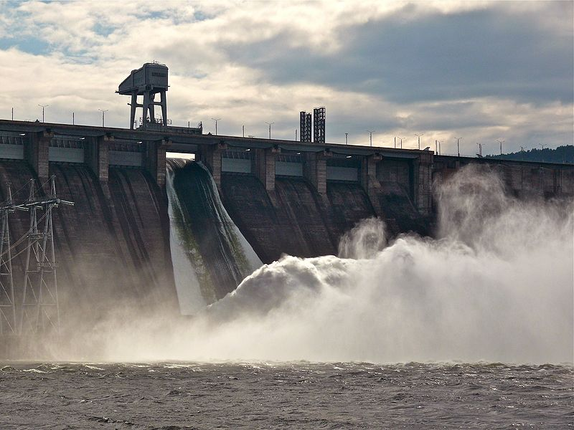
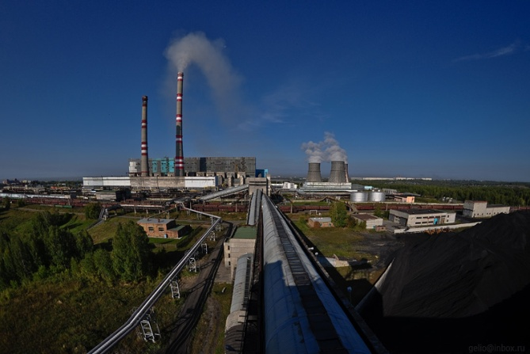
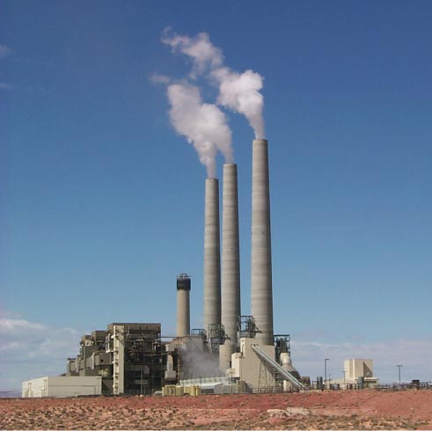
Energy Sector Projects
Energy sector key projects that DBM is considering to get involved
Shuren Hydro Power Station
Ulaanbaatar CHP-5 Phase 1
Tavan Tolgoi CHP
Capacity
300 MW
Capacity
450 MW
Capacity
600 MW
Investment
amount
USD 430 mln
Investment
amount
USD 688.7 mln
Investment
Amount
USD 900 mln
Period
2011-2018
Period
2011-2015
Period
2012-2016

Slide 12
Energy Sector Projects
Ministry of Mineral Resources and Energy presented potential project list in “Mongolian Power 2011”. DBM is studying and preparing to get involved in these projects.
 | Energy source | Installed capacity | investment needs | Construction start/end year
Near Term (2012 2015) | New energy source in Eastern regional | 100 megawatt | 150 mln USD | 2012/2015
 | Thermal power plant at Mogoi river mine deposit | 60 megawatt | 110 mln USD | 2011/2013
Mid Term (2016 2021) | Ulaanbaatar combined heat and power plant no 5, phase 2 | 370 megawatt | 711.6 mln USD | 2015/2020
 | System regulator hydropower plant (Orkhon, Egiin river) | 220 megawatt | 350 mln USD | 2013/2017
 | Bayarteeg thermal power plant | 40 megawatt | TDB by F/S | 2013/2016
 | New energy source at Khotgor, Khar tarvagatai coal mines | 40 megawatt | TDB by F/S | 2013/2016
 | Baganuur thermal power plant | 270 megawatt | TDB by F/S | 2013/2016

Slide 13
Energy Sector Projects
Energy sector projects that DBM is permitted to provide financing according the Government Resolution # 149 of 2011 and belong to “New Development Program”.
We are on the process to provide for the below mentioned “Electricity transmission grid and heat supply project” among New Development Program
[category 1] with detailed design (total project cost 4.5 billion MNT)
- IV'th heat supply facility at Bayangoliin am
1.8 km's long second master line's reconstruction work from east crossroad to Military officer's palace
[category 2] without detailed design
8 project including transmission lines and sub-station projects in the areas of Yarmag, Songino, Buyant-Ukhaa, Neew Yarmag, and new city center etc.
(total project cost 50.8 billion MNT)

Slide 14
Typical Financing Structure for Power Project
Indonesia Paiton Power Plant Project Case
Operating Company
Coal
Supplier
O&M
FSA
Construction Company
Project Company
PPA
Power
Purchaser
EPC
Syndicated Loan
JBIC Loan : U$900m
US Exim Loan : U$540m
OPIC : U$200m
Commercial Banks : U$180m
Project
Sponsor
EQUITY

Slide 15
How DBM can support Energy Sector Projects
For small-scale projects:
Direct loan
Arranging other funding sources
Advisory services
For large scale projects:
- Co-financing/ Syndicated Loan
For large scale projects, usually one lender can not handle the whole financing need.
DBM has vast relationship with MLA(World Bank, IFC, ADB, EBRD, etc), ECA(US Exim, China Exim, JBIC, KEXIM, etc) and international financial institutes.
As DBM is Mongolian bank and understands well the energy industry and legal system in Mongolia, we can co-finance this project with other international financial organizations
DBM will arrange the co-financing or take part in the project financing as a participant.

Slide 16
How DBM can support Energy Sector Projects
Financial advisory service
We can provide financial advisory service to Mongolian companies
We can also advise on Financial structuring, Project structuring, comment on project agreement to be bankable, induce international financial institute, negotiation on financial terms etc.
Organize feasibility fund for initial stage
With the help of international donors such as JAICA, KOICA, Kuwait Fund, we can facilitate funding for feasibility studies in the initial stage.

Slide 17
Issues to be addressed
Legal and regulatory framework should be clearly defined and adjusted to reflect the current situation
Concession Law, Power Purchase Agreement, etc.
Projects and programs should be prioritized according to the rationality, not political purpose
Lack of funding source, projects should be prioritized according to its feasibility and importance in Mongolian economy
Quality and ability of state-owned entities should be improved
Mongolian project company should be ready to perform this project
Government level capacity building on project development and monitoring skills including feasibility study development, project management and appraisal.

Slide 18
Thank you for your attention…
Development Bank of Mongolia Government Building II, United Nations Street 5-1, Ulaanbaatar Mongolia
Phone. Fax. Web. Email. | (976) 7013 0513 (976) 7013 0602 www.dbm.mn info@dbm.mn
For further information please contact to:

