Slide 1
Project of Increasing Current capacity of Erdenet Power Plant

Slide 2
Current capacity
ETPP was first planned to produce 302.5 Gkal heating energy and 28,8 MW hour electricity and as well as its technical and economical specification
Basic equipment
Boiler BKZ-75-39FB 7 pcs
Turbine PT-12-35/10m 1 pc
Turbine P-12-35/5 2 pcs
Heating Equipment:
Fundamental Boiler PSB-500-3-23 2 pcs
Additional Boiler PSB-500-14-23 2 pcs
Boiler Condensing Freezer PSB-315-14-23 2 pcs
Network Pump SE-1250-140-11-04 4 pcs
Network Pump SE-500-70 1 pc

Slide 3
Main Specifications of the Plant
№ | Main Specifications of the Plant |  | Unit | T&ES
 |  |  |  | As Project | In 2011 | Difference
1 | Electricity produced per year |  | Mil/kW | 162.3 | 134.59 | -27.71
2 | Electricity distributed per year |  | Mil/kW | 127.4 | 106.0 | -21.4
3 | Domestic supply of electricity |  | % | 21.5 | 21.24 | +0.26
4 | Heating energy distribution /total/ |  | Th/Gkal | 966.8 | 521.67 | -445.13
 | Heating energy distribution | Vapor | Th/Gkal | 259.5 | 30.709 | -228.79
 |  | Water | Th/Gkal | 707.3 | 490.96 | -216.34
5 | Fuel own consumption | For electricity | g/kWh | 225 | 315.59 | +90.59
 |  | For heating | kg/Gkal | 178 | 184.79 | +6.79
6 | Working hours of electrical capacity per year as project |  | Hour | 4508 | 3739.0 | -769.0
7 | Working hours of boilers’ installed capacity per year |  | % | 6-8 | 9.4%

Slide 4
Extension rationales
1. The TG-1turbinegenerator’s working hours has been in excess of 150000 hours of guarantee given by the factory /worked 188234 hours totally/
2. Not operating at full installed capacity
Electricity energy production: 162.3 mil/kW/134.6 mil/kW
Heating energy distribution: 955.25 th/Gkal/521.7 th/Gkal
3. Production costs of electricity and heating energy is high
Electricity energy - 115¥/kW (87,7)
Heating energy - 17500¥/Gkal (6500)
4. Installed capacity of energy system is 630MW, the consumption has reached to 802MW in 2012, and it has been rising constantly.

Slide 5
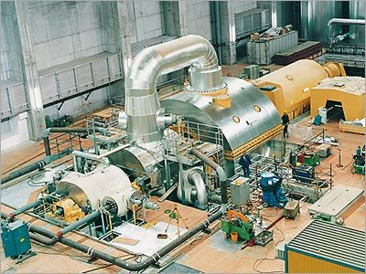
Resolutions :
To extend with 30MW PT Turbine
2. Replace the backpressure P Turbine
with Turbine PT-12
3. Installing a 25MW Turbine with 5-7 ata at 280-300ºC

Slide 6
Necessary basic accesses to the extension:
Boiler
Turbines
4 hectare empty space
1. Having 4.0 hectare-own land to build extension and Grader cooling system

Slide 7
Necessary basic accesses to the extension:
2. Having enough capacity of equipment for additional 3 boilers

Slide 8
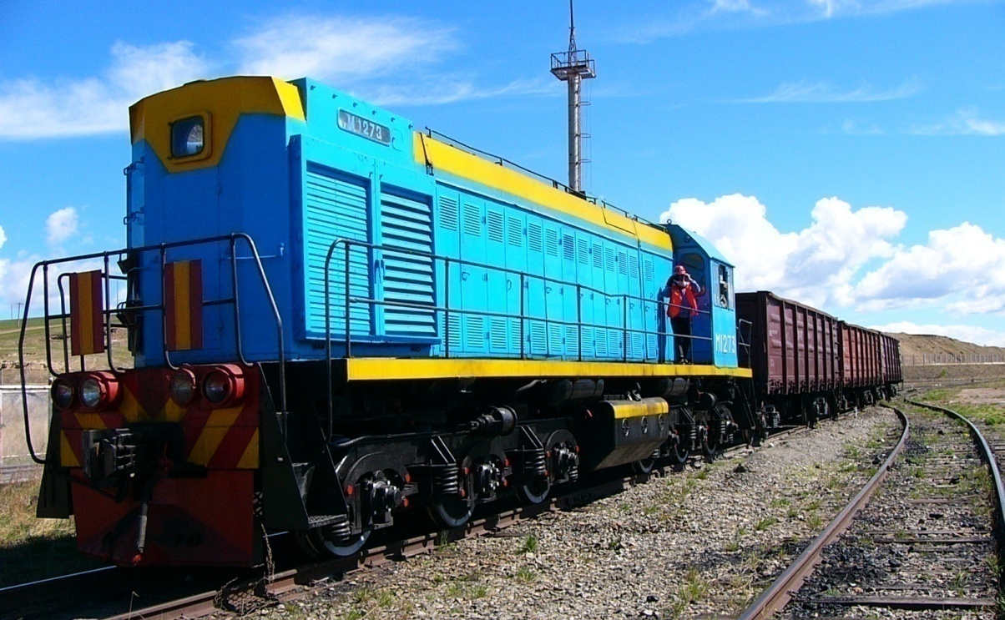
Necessary basic accesses to the extension:
3. Having own conveying wagons and railway to receive coals from mining

Slide 9
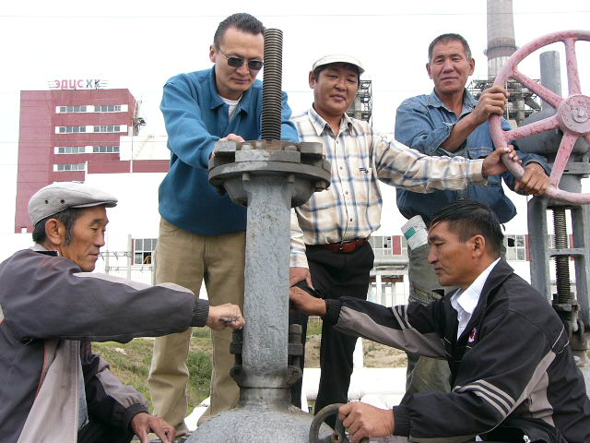
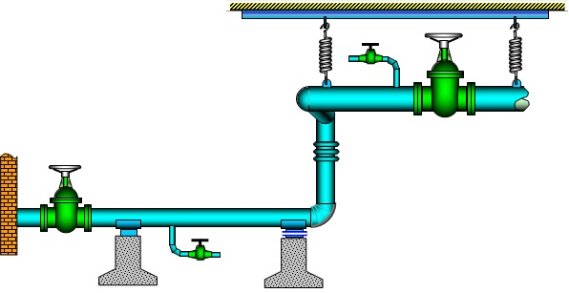
Necessary basic accesses to the extension:
4. The heating distribution network is one of the sections at the plant and heating energy selling is made by Sales Department at the plant. The plant has a monopoly of producing heating energy in Erdenet.

Slide 10
Necessary basic accesses to the extension:
5. It is possible to be supported by the State as it’s State Share-Holding company.

Slide 11
Aspects has to be solved during the extension:
To estimate it to work in warm seasons under the condensation mode when installing a new turbine condensate
To build a new gradient as capacity of the cooling water pond is not enough
To build a new additional boilers as the consumption in Erdenet is constantly increasing

Slide 12
Technical and Economical Specifications of Extension Project
№ | Technical and Economical Specifications |  | Unit
1 | Installed capacity |  | MW | 66
2 | Project capacity |  | MW | 53.8
3 | Working hours of installed electrical capacity per year |  | Hour | 4695.3
4 | Electricity produced per year |  | Mil/kW | 309.89
5 | Electricity distributed per year |  | Mil/kW | 248.64
6 | Electricity | Real | Mil/kW
7 |  | Rate | % | 19.76
8 | Thermal energy production | Total | Th/Gkal | 555.2
9 |  | Vapor | Th/Gkal | 30.0
10 |  | Water | Th/Gkal | 525.2
11 | Planned Fuel own consumption | For electricity | g/kWh | 641.85
12 |  | For heating | kg/Gkal | 180.26
13 | Coal consumption per year | As planning | Mil/Ton | 259.6
14 |  | In reality | Mil/Ton | 494.8
15 | Coal heat capacity |  | Gkal/kg | 3673.4

Slide 13
Cost accounting
16 | Total expenses | 30.868.377.3 thous.tug
17 | Thermal energy income | 4.279.447.3 thous.tug
18 | Electricity income | 28.687.647.1 thous.tug
19 | Total income | 32.967.094.4 thous.tug
20 | Electricity Tariff | 115,4 ₮/kWh
21 | Thermal energy average cost | 7706,8 ₮/Gkal
22 | Product cost of electricity | 81.1 ₮/kWh
23 | Product cost of thermal energy | 19.263.4₮/Gkal
24 | Investment | 27.604.000.0 th/₮
25 | Duration of pay back | 12.95 year

Slide 14
Equipments and cost to extension
№ | Equipments to be built | Required budget /mil.dollars/ | Explanation
1 | Turbine PT-30-3.4/10, its accessories, lines, extension building, gradient, electrical generator, transformation, and oil cutter | 17.5 | Compared the cost of Turbine extension at the Darkhan Thermal Power Plant
2 | Boiler construction | 1.2 | Current market price
3 | To reassemble the grader and cooler system | 1.6 | Current market price
4 | To install 35kW power line with its relay and oil cutter | 0.3 | In the magazine “Power Energy” #1 /page 45/
 | Total | 20.6

Slide 15
The amount of an import of electricity energy will decrease when there is a stable resource of power energy in Erdenet region.
It will be able to supply Erdenet consumers with reliable heating energy
The amount of production of electricity energy will increase by approximately 175.3 mil/kW per year, production cost will be fallen from 85.39 tug/kWh to 73.6 tug/kWh, and the percentage of the domestic consumption of electricity will decrease to 19.76%.
The plant will be able to work continually and constantly and the working hours of installed capacity will increase.
The capacity and reliable production of the heating water construction network in Erdenet will improve.
Conclusion
Advantages

Slide 16
THANK YOU FOR ATTENTION!

