Slide 1
The Nuclear Power Program of the Czech Republic and the Cooperative Relationship with the Republic of Korea
KAP 2020, July 16, 2020 Busan
Gustav Slamečka, Ambassador of the Czech Republic to ROK

Slide 2
Contents
Overview of the Czech Nuclear Energy Sector – Czech Ministry of Industry and Trade
Nuclear Research Institute – ÚJV Řež
Thermonuclear Fusion Research – Czech Academy of Science
Cooperation between ROK and the Czech Republic in Nuclear Energy
Presentation can be downloaded on https://www.mzv.cz/seoul/en/index.html

Slide 3
Climate Neutrality Commitment
Czech Republic (CR) joined EU´s commitment in climate neutrality by 2050,
CR welcomes the crucial role of nuclear energy in achieving climate neutrality in the European Commission´s Communication „A Clean Planet for All“ and in the European Parliament´s Opinion on COP26,
Potential of nuclear energy to reduce CO2 emissions recognized by OECD and the UN,
CR claims that in accordance with Article 194 TFEU (Treaty on the Functioning of the EU) every Member State has the right to determine the primary composition of its energy supply and the conditions for the use of its energy sources,
CR intends to transparently communicate all steps of its nuclear project development with the European Commission, international partners and welcomes support from other countries.

Slide 4
Energy Mix Development
The current brown-coal capacity of approx. 10,800 MW should be reduced to approx. 6,400 MW by 2035, and then to approx. 2,600 MW by 2040,
Share of coal sources in the generation of electricity power by 2040 will fall from the current 47 % to between 11% to 21%, as stated in the State Energy Policy. Phasing out coal sources is the main factor for the timely preparation of the construction of new nuclear units,
The state Energy Policy also takes into account the potential availability of other sources of electrical power (in particular renewable energy sources) and other energy policy instruments (in particular energy savings),
Renewable energy sources will continue to play an important role in the energy transformation, however, the Czech Republic‘s potential for the development and use of renewable energy sources is limited by natural conditions and requirements of environmental protection.

Slide 5
Development of the Nuclear Energy Sector
End of operating lifetime of existing units in Dukovany,
Due to geographical conditions and structure of the economy, nuclear energy is considered as the main option for the construction of an emission-free, stable energy source,
Development of a new nuclear power plant in Dukovany (1000 - 1200 NW) under preparation – expected operation 2036,
Consideration given to the construction of other new builds, increase of nuclear power generation share to approx. 50% in 2040, attention given also to SMRs,
Following recommendations of international organizations, the Czech Republic will provide support by ensuring a legislative and regulatory environment, by guaranteeing ROI and by securing advantageous financing under EU and state aid rules.

Slide 6
Dukovany Project
Existing reactors put in operation 1985 – 1987, expected lifetime till 2045-2047,
New reactor can coexist with existing reactors = priority on Dukovany,
Construction carried out by 100% owned subsidiary of CEZ (Dukovany II Power Plant) with certain state guarantees. The relationship between the state and CEZ will be regulated by agreements for this specific project,
State wants to safeguard its security interests during the preparation and implementation of the project, CEZ will be provided to safeguard the project and suitable framework conditions,
State will exercise control over the construction process and define rights and obligations of both parties, including the possible takeover of the investor company by the state. Agreements will provide for possible changes in regulatory and legislative environment,
State will supervise and secure its primary security interest through the investor, especially in the process of supplier selection.

Slide 7
Timeline of Dukovany Project
Start of the tender 1Q 2021
Start of Notification process EU – 1-2Q 2021
Notification process completed 4Q 2022
Selection of supplier – end of 2022
Start of construction 2029
Operation 2036

Slide 8
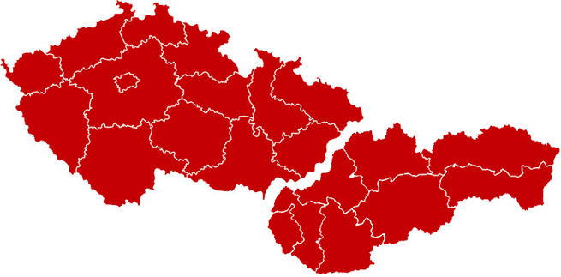
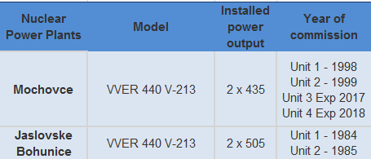
Nuclear Energy Sector CR and SR
NPP Temelin 2x WWER 1000
NPP Dukovany 4x WWER 440
Hradec Králové
Prague
Pardubice
Pilsen
Czech Republic
Olomouc
Zilina
Brno
Slovak Republic
Ceské Budejovice
Kosice
Bánská Bystrica
Bratislava
NPP Jaslovské Bohunice 2x WWER 440
NPP Mochovce 2x WWER 440

Slide 9
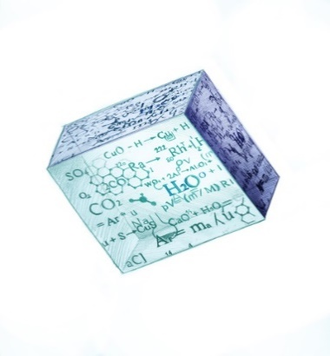
Portfolio of Products and Services
Designing and engineering activities
Feasibility and conceptual studies
Construction site surveys and specifications
Documentation within the scope of current legislation
Support for the operation of conventional power stations and heating plants
Optimization of operation and infrastructure
Greening and modernization studies and projects
Support for the operation of nuclear power plants
Lifetime and efficiency improvement
Safety, reliability, diagnostics and equipment qualification
Radioactive waste and decommissioning
Radioactive waste management and repositories, spent fuel transportation
Decommissioning, fragmentation and decontamination services
Radiopharmaceuticals
Manufacturing, quality control and distribution of medicinal products for Positron emission tomography (PET)
Complete PET centres construction and operation
Applied research and development
Services in the field of nuclear energy and ionizing radiation utilization

Slide 10
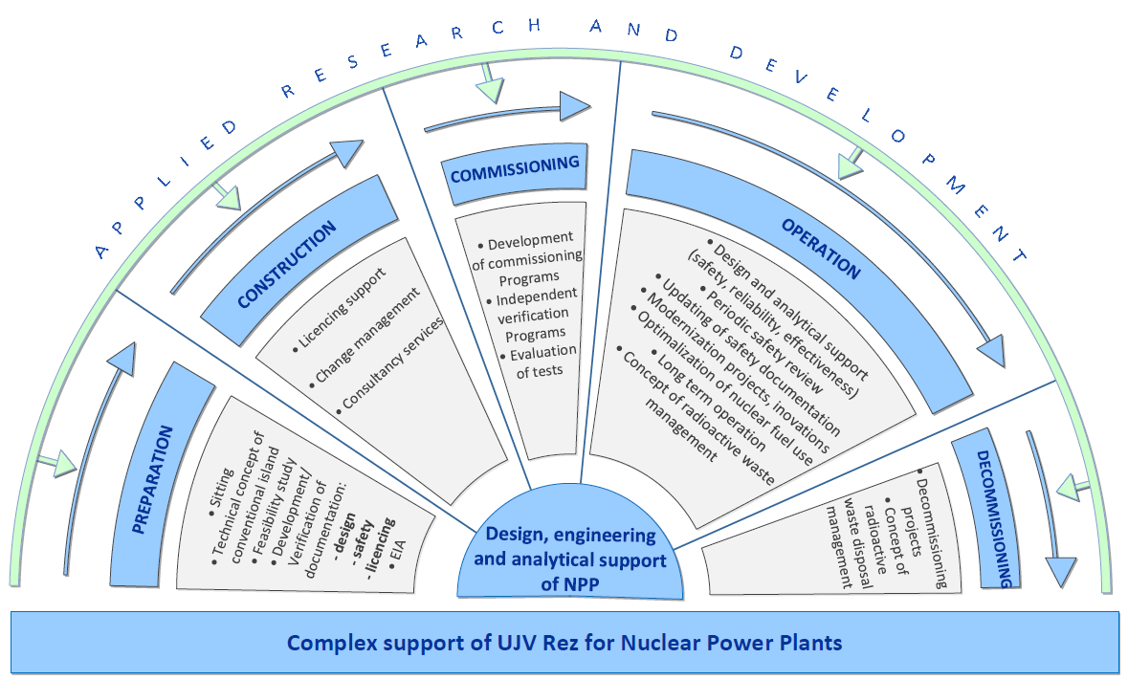
Scope of Services related to NPP

Slide 11
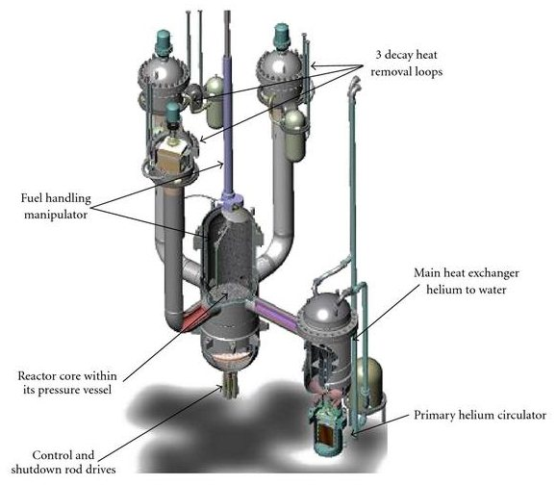
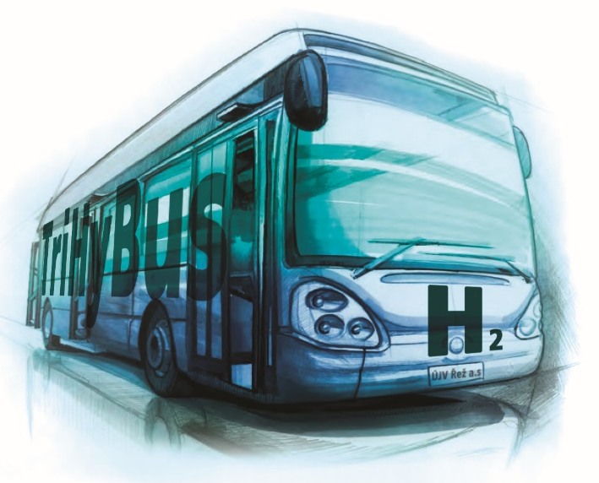
R&D and Innovation Activities
Corium retention, stabilization and ensuring the long-term integrity of the Temelin NPP containment
Finalization of the calculation model for the In Vessel Retention strategy, construction of the THS-15 experiment
Hydrogen Technologies
Use of hydrogen in the field of transportation - Hybrid vehicles and vehicle control systems (TriHyBus, HyVan)
Energy accumulation
Systems for CO2 capture – CCS
Founding member of the Czech Hydrogen Platform (HYTEP)
Research and development of materials for nuclear and non-nuclear use
Evidence and temporary storage of irradiated construction materials and specimens from irradiation experiments, RPV surveillance programs and decommissioned NPPs
Material experiments in the hot and semi-hot cells
IV Generation Fast Reactors
Allegro project –technical solution of a demonstrator for the Fast Gas Cooled IV Generation Reactor

Slide 12
Multilateral International Cooperation
Multilateral cooperation
International Atomic Energy Agency (IAEA), Vienna
Nuclear Energy Agency (NEA), Paris
EURATOM Framework Programmes
EPRI
Member of the Sustainable Nuclear Energy Technology Platform (SNETP)
Member of the European Nuclear Education Network (ENEN)
Member of the European Technical Safety Organisations Network (ETSON)
Bilateral cooperation
Alternative Energies and Atomic Energy Commission (CEA), France
Institute for Radiological Protection and Nuclear Safety (IRSN), France
Gesellschaft für Anlagen-und Reaktorsicherheit (GRS), Germany
Czech-Russian Working Group for Nuclear Energy, MPO/ROSATOM, Russia
State Scientific & Technical Centre for Nuclear and Radiation Safety, (SSTC NRS), Ukraine
Cooperation with US institutes through US NRC and DoE
Bhabha Atomic Research Centre, India
Electric Power Research Institute, USA
and others

Slide 13
Cooperation with South Korea
As example of cooperation with Korean company we can present the contract with KEPCO Engineering & Construction Co., Inc. that was carried out last year and covered consulting of leak before break evaluation methodology with respect to legal documents, practice and experience in the Czech Republic. The consultancy was not limited only to LBB and protection of high energy piping, but also Czech designing practice was discussed.
Another example is cooperation in the Equipment Qualification area. UJV testing laboratory has qualified cables produced by Habia Cable that are currently used in Korean NPPs. At present UJV finishes 5 years collaboration with Korean Company GOC (Global Optical Communication Korea) on nuclear fiber optic cables qualification. KEPCO representatives audited and approved UJV as an EQ testing laboratory.

Slide 14
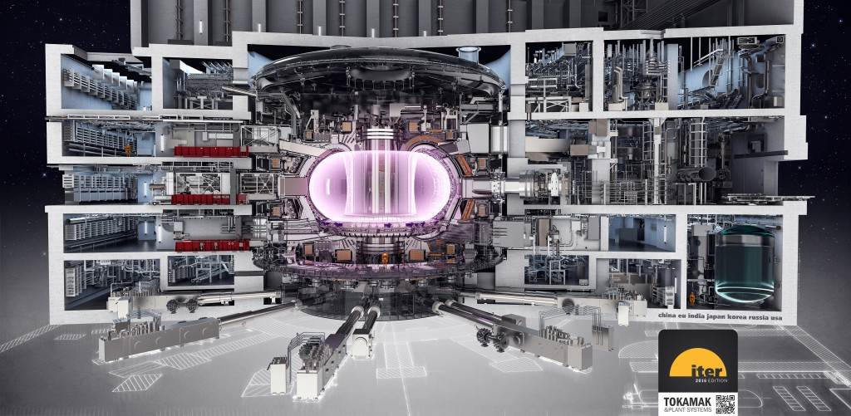
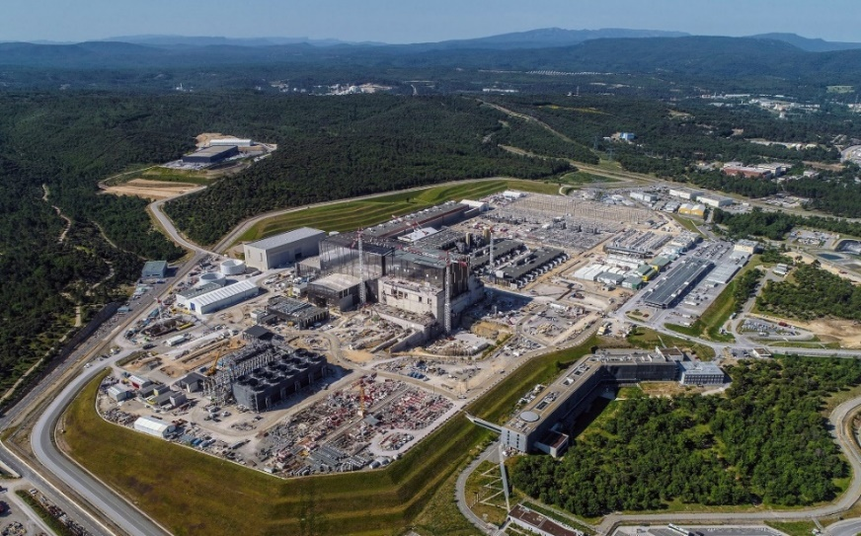
Introduction to Magnetic Thermonuclear Fusion Research
uuuuuufusion research
huge potential as a future source of safe, inexhaustible and clean energy
EU follows a „European roadmap to the realization of fusion energy“
Aim – first electricity from fusion in a grid around 2050
EU fusion research organized and coordinated within the EUROfusion consortium
The whole world joins effort in construction of the ITER tokamak in France – largest international scientific experiment in the world (approx. 18 billions Euro)
ITER will start operation in 2025
ITER goals: production of 500 MW of fusion power and integrated test of all key technologies
Cross-section of the ITER tokamak
lTER construction site (May 2020)

Slide 15
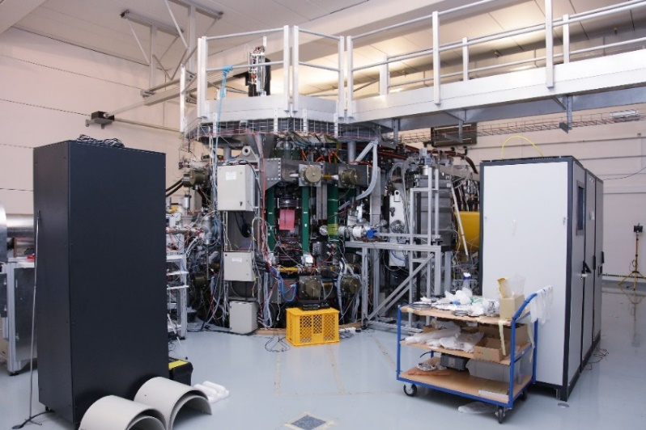
Thermonuclear Fusion Research in the Czech Republicsion research
Institute of Plasma Physics (IPP) of the Czech Academy of Sciences - 50-years tradition in fusion research
Gradually becoming one of the leaders in fusion research in Europe
IPP is a member of large European EUROfusion consortium (under EURATOM) and coordinates this research within CR
Since 2008 IPP successfully operates large research facility – the COMPASS tokamak
Significantly contributed to solution of several key challenges of design and future exploitation of ITER
Main research activities:
plasma-facing component and advanced materials
new plasma operational scenarios
development of advanced diagnostics for harsh environment
The COMPASS tokamak will be shut down this year to allow construction of new significantly advanced tokamak – COMPASS Upgrade
The COMPASS tokamak – second floor
Plasma inside the COMPASS tokamak

Slide 16
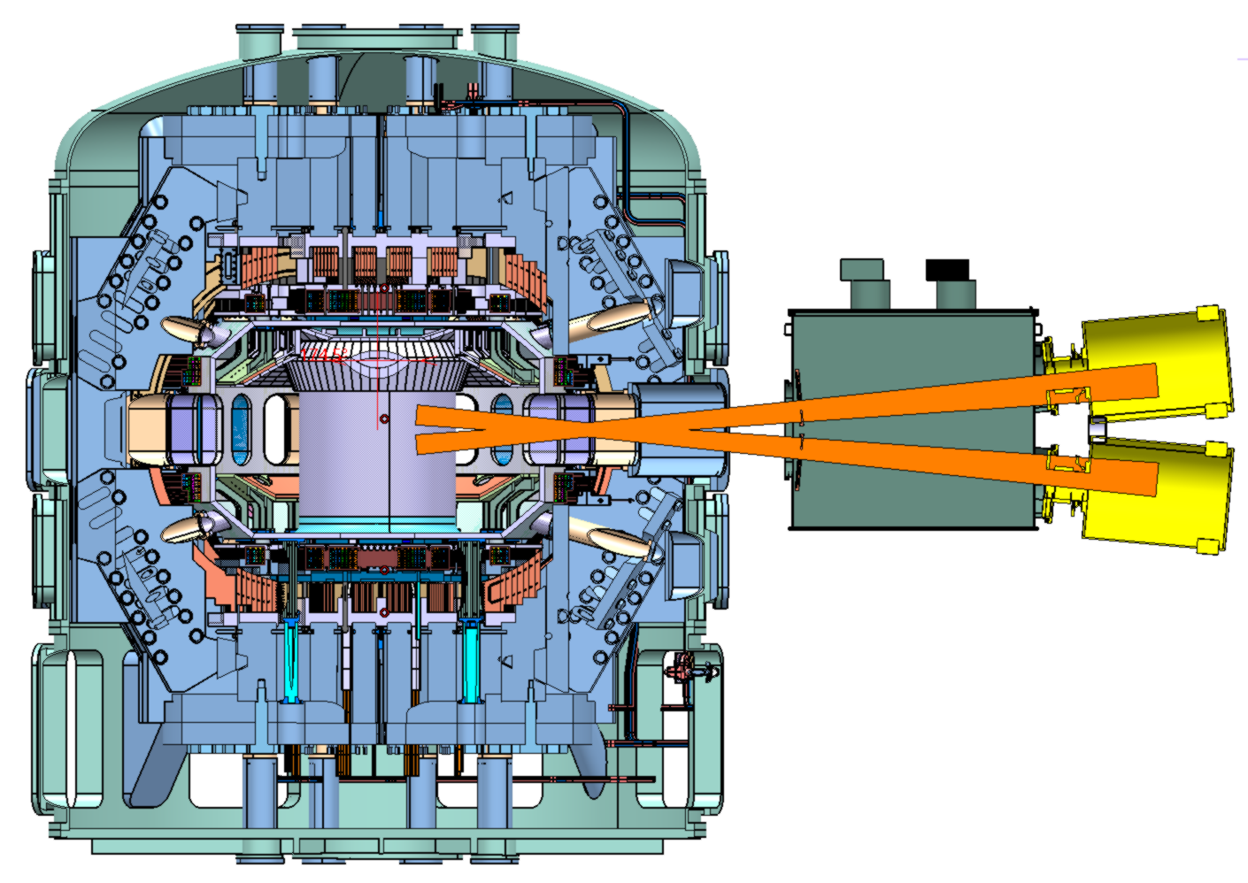
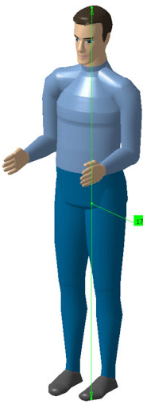
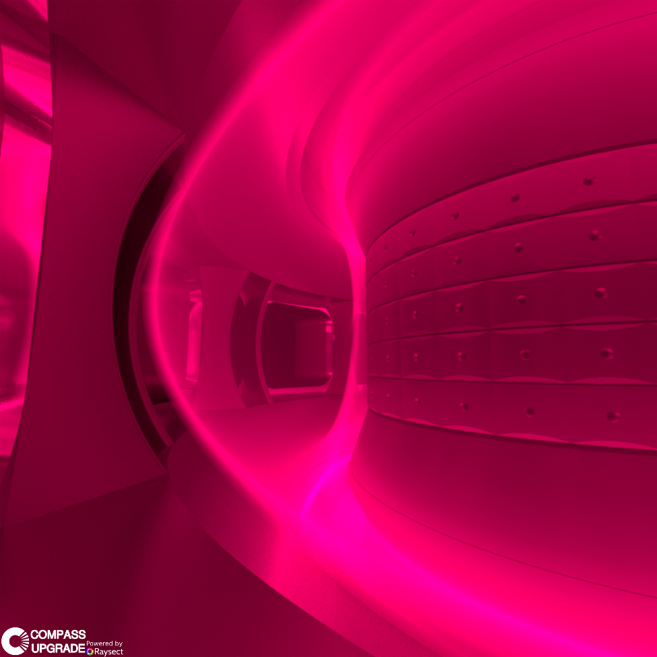
COMPASS-U new Experimental Fusion Device under Construction in the Czech Republicn research
A high-magnetic field tokamak (magnetic field of 5 Tesla)
The only device in the world with the magnetic field magnitude and plasma shape similar to ITER and the future prototype of fusion reactor - DEMO
Several world-unique features enabling to address the key challenges for the design and construction of DEMO
COMPASS-U will server as EU testbed for liquid metal technology in fusion
Project started in 2017
Scientific exploitation will start in 2023
Collaboration with world-leading laboratories including National Fusion Research Institute in Daejeon, South Korea
Cross-section of the COMPASS-U tokamak
Future plasma in
the COMPASS-U tokamak

Slide 17
Cooperation between Korean and Czech Companies
KAERI
MOU - Nuclear Research Institute ŘEŽ
Expert visits, joint research projects, experimental testing, participation in technical workshops,
Nuclear forums, Conferences
Czech Technological Agency (TACR) cooperates with KIAT and KETEP (Delta 2 Program)
KEPCO - MOU with Nuclear Research Institute ŘEŽ
KHNP - MOUs with ČEZ, NRI ŘEŽ, Doosan Škoda Power, Metrostav (Czech building company),
Visiting interaction, Cooperation with Czech Government, Parliament, Municipalities
Volunteer activities, Sponsorship of Sport Clubs.

Slide 18
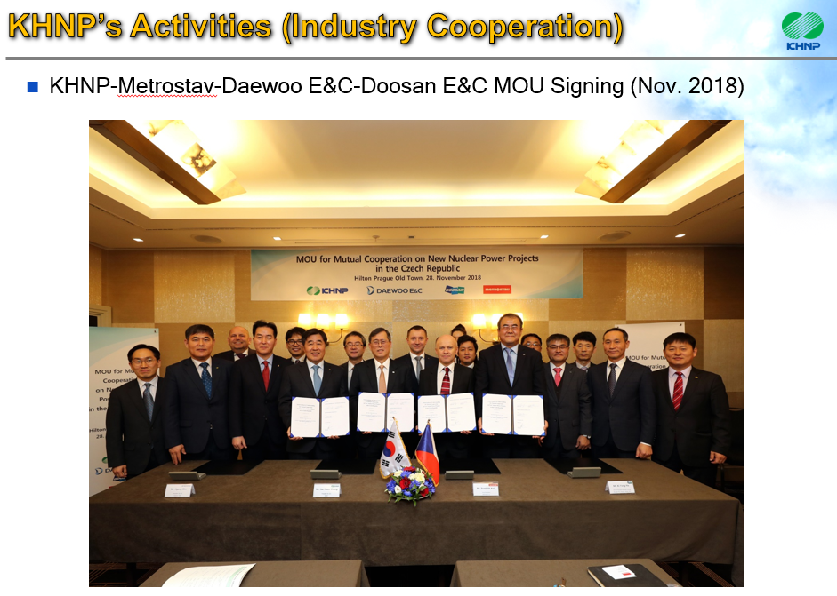
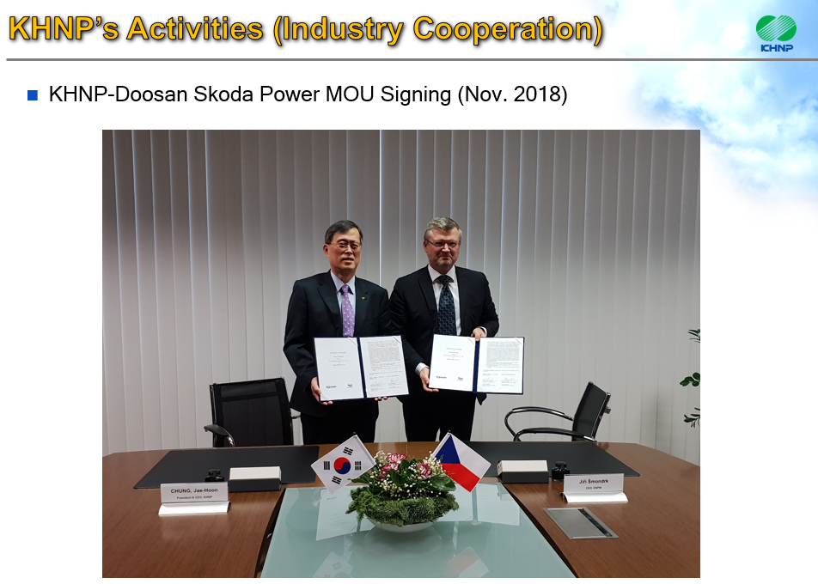
KHNP’s Activities
Notes:
In January, KHNP had two days Technical Seminar about APR 1000 reactor technology by organizing from the Ministry of Industry and Trade in Czech.
In total, over 60 experts of both sides came there and 21 technical presentations were presented to Czech experts.
Various questions and answers were proceeded and it was a good opportunity to understand the Korean reactor technology.

Slide 19
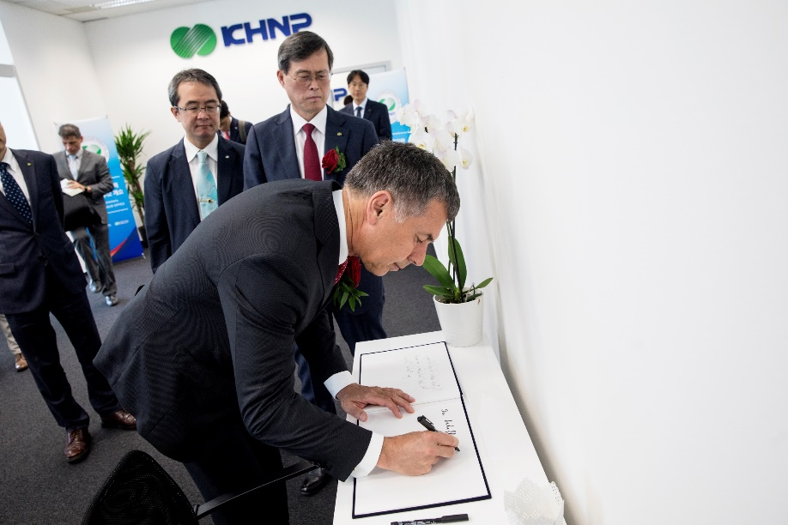
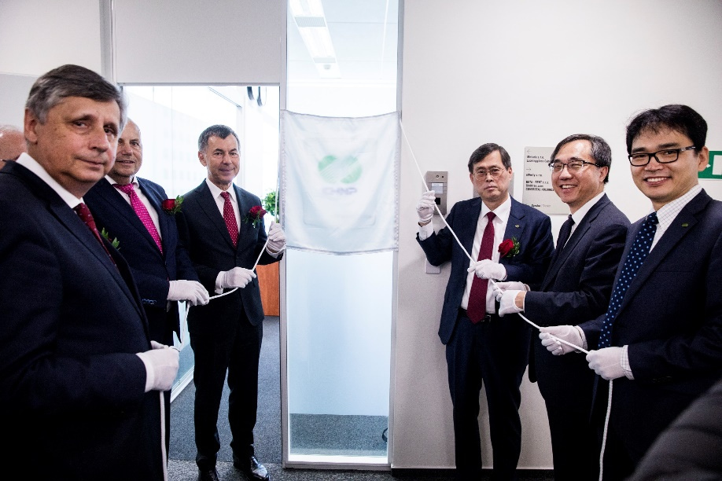
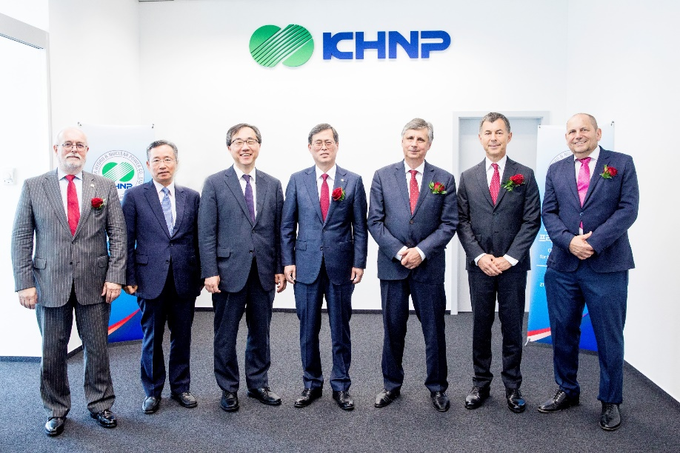
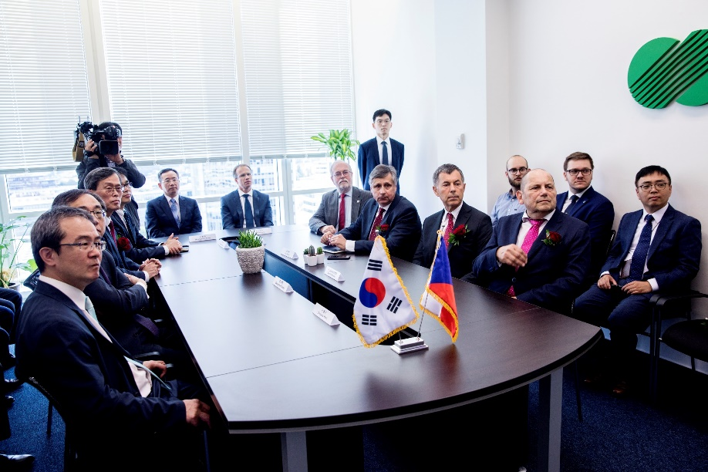
KHNP’s Activities
Opening Ceremony of KHNP Prague Office (Jun. 2019)
Notes:
In January, KHNP had two days Technical Seminar about APR 1000 reactor technology by organizing from the Ministry of Industry and Trade in Czech.
In total, over 60 experts of both sides came there and 21 technical presentations were presented to Czech experts.
Various questions and answers were proceeded and it was a good opportunity to understand the Korean reactor technology.

Slide 20
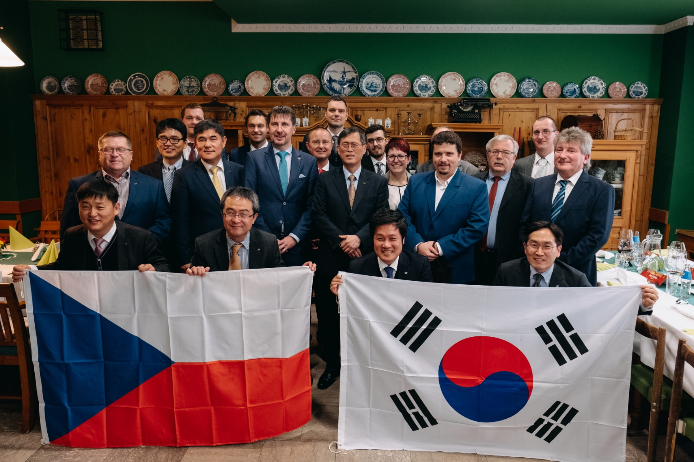
KHNP’s Activities (Industry Cooperation)
Meeting with local municipalities & companies (Nov. 2018)
Notes:
In January, KHNP had two days Technical Seminar about APR 1000 reactor technology by organizing from the Ministry of Industry and Trade in Czech.
In total, over 60 experts of both sides came there and 21 technical presentations were presented to Czech experts.
Various questions and answers were proceeded and it was a good opportunity to understand the Korean reactor technology.

